Slide 1
Solid Edge Developer Assembly
Art Patrick – Solid Edge Assembly

Slide 2
Agenda
Addin for SE ASM
Uses UI Sample from Codeplex
Edgebar Pane
Addin Commands
SE Mouse Control

Slide 3
Overall Goals
Commands always available
Action Object Display toggles
Query and select part file names
Replace Part with Copy and Auto-Rename

Slide 4
Primary files
Insert Component (New Command)
Parts Library Preview
Placement Methods

Slide 5
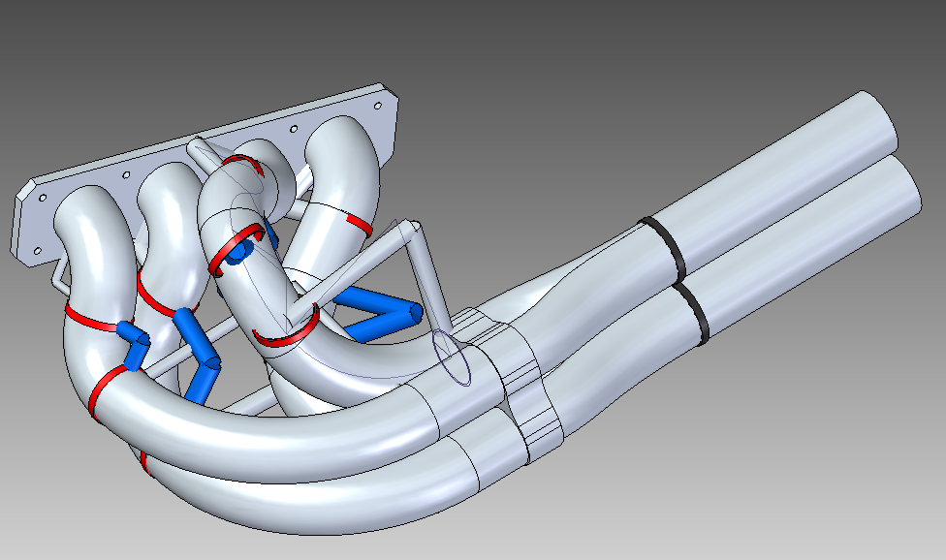
Demonstration
Let’s take a look

Slide 6
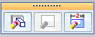
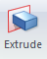
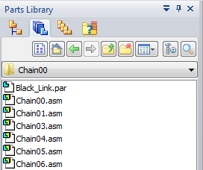

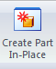

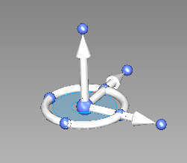
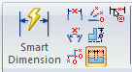
Assembly Design
Questions?

Slide 7

Solid Edge Developer Assembly
Be sure to check out:
Taking Assembly Design to the Next Level: Advanced Assembly Topics
We’re Listening: Assembly Round Table
Thank You

